Slide 1
Chemical reactions can be classified
Synthesis Reaction – combines two or more simpler reactants to form new, more complex products.
N₂
+
2O₂
2NO₂
Nitrogen
Oxygen
Nitrogen Dioxide
O
O
N
N
+
O
O
Simple to complex

Slide 2
Chemical reactions can be classified
Decomposition reaction – breaks a reactant into two or more simpler products
2H₂O
2H₂
+
O₂
Water
Hydrogen
Oxygen
H
H
O
+
Complex to simple
H
H
O

Slide 3
Chemical reactions can be classified
Combustion Reaction – always involves oxygen (O₂) as a reactant.
CH₄
+
2O₂
CO₂
+
2H₂O
Methane
Oxygen
Carbon Dioxide
Water
O
O
H
H
+
C
+
H
H
O
O

Slide 4
Chemical reactions can be classified
Replacement Reaction – elements switch places to form new compounds.
1) Single Replacement
Zn
+
2HCl
ZnCl₂
+
H₂
Zinc
Hydrochloric Acid
Zinc Chloride
Hydrogen
Zn
+
Cl
Cl
H
H
+
Cl
Cl
H
H

Slide 5
Chemical reactions can be classified
Replacement Reaction – elements switch places to form new compounds.
1) Single Replacement
2) Double Replacement
FeS
+
2HCl
FeCl₂
+
H₂S
Iron Sulphide
Hydrochloric Acid
Iron Chloride
Hydrogen Sulfide
Fe
+
Cl
H
+
S
Cl
H

Slide 6
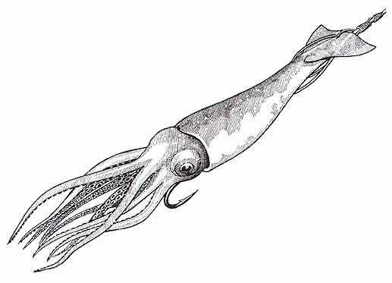
How to remember the four types of Chemical Reactions.
Squids don’t carry roses.
Synthesis
Decomposition
Combustion
Replacement

Slide 7
Types of Chemical Reactions
Sean Gillette, EdD
Master Teacher Project
Betterlesson.com
July 13, 2014

