Slide 1
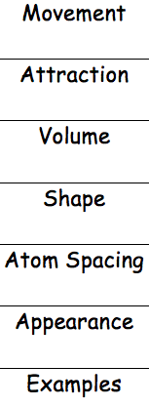
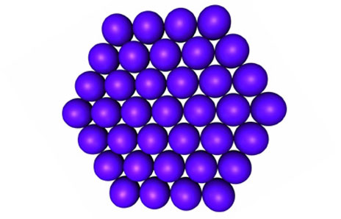
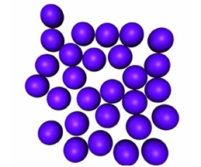
Solid, Liquid, Gas
PROJECT
Matter Foldable
Start by folding paper the Hot Dog way
FRONT DOORS
INSIDE
SOLID
LIQUID
GAS
SOLID
LIQUID
GAS

