Slide 1
Newton’s 3rd Law

Slide 2
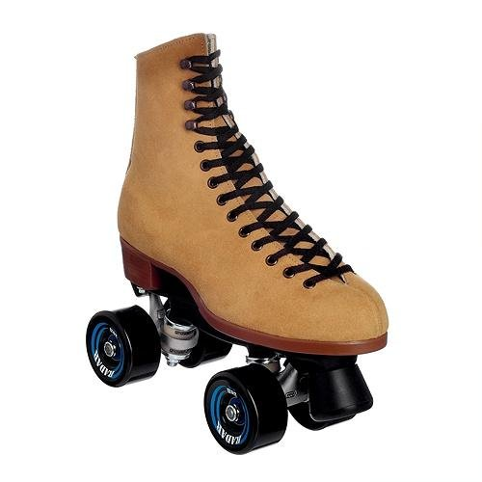
Overview
Have you ever tried to teach a friend how to roller-skate? It’s hard if you are both wearing skates. When your friend pushes against you to get started, you move too. And when your friend runs into you to stop, you both end up moving! To understand these movements you need to know Newton’s third law of motion.

Slide 3
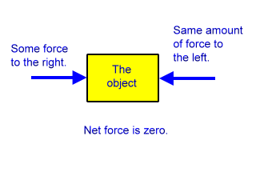
Newton’s 3rd Law
Before getting into Newton’s 3rd Law it is important to point out that the other laws we have studied deal primarily with forces acting on ONE object.

Slide 4
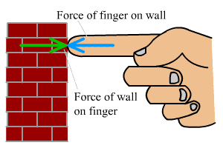
Newton’s 3rd Law
Newton’s 3rd Law has more than one object involved.
Newton proposed that whenever one object exerts a force on a second object, the second object exerts a force back on the first object.

Slide 5
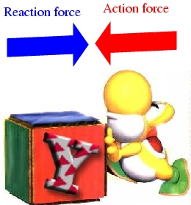
Newton’s 3rd Law
The force exerted by the second object is equal in strength and opposite in direction to the first force.
Think of one force as the “action” and the other force as the “reaction.”

Slide 6
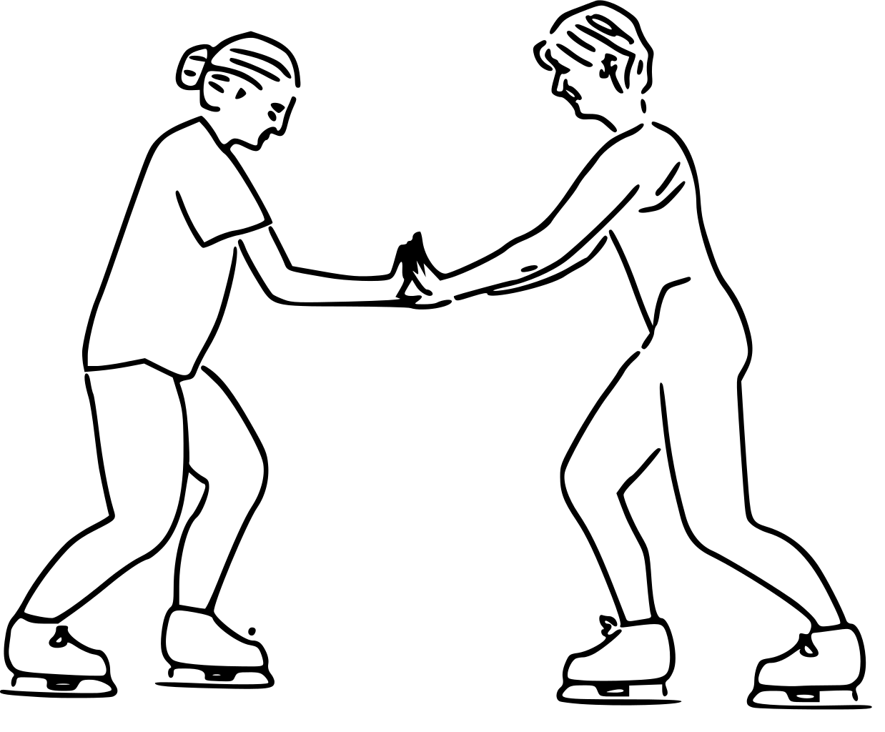
Newton’s 3rd Law
Newton’s third law of motion states that if one object exerts a force on another object, then the second object exerts a force of equal strength in the opposite direction on the first object.
Another way to state Newton’s third law is that for every action there is an equal but opposite reaction.

Slide 7
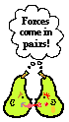
Action-Reaction Pairs
Pairs of action and reaction forces are all around you.
When you jump, you push on the ground with your feet. This is an action force. The ground pushes back on your feet with an equal and opposite force. This is the reaction force. You move up when you jump because the ground is pushing you.
Turn to your neighbor without leaving your seat and come up with another example of Newton’s 3rd law.

Slide 8
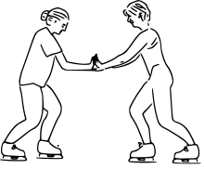
Action-Reaction Pairs
Now you can understand what happens when you teach your friend to roller skate.
Your friend exerts an action force when he pushes against you to start.
You exert a reaction force in the opposite direction.
As a result, both of you move in opposite directions.

Slide 9
Detecting Motion
Can you always detect motion when paired forces are in action?
The answer is no.
For example, then Earth’s gravity pulls on an object, you cannot detect Earth’s equal and opposite reaction.
Suppose you drop your pencil. Gravity pulls the pencil downward. At the same time, the pencil pulls the Earth upward with an equal and opposite reaction force. You don’t see Earth accelerate toward the pencil because Earth’s inertia is so great that its acceleration is too small to notice.

Slide 10
Do Action-Reaction Forces Cancel?
Earlier you learned that if two equal forces act in opposite directions on an object, the forces are balanced.
Because the two forces add up to zero, they cancel each other out and produce no change in motion.
Why don’t the action and reaction forces in Newton’s 3rd law of motion cancel out as well? After all, they are equal and opposite.

Slide 11
Do Action-Reaction Forces Cancel?

Slide 12
Do Action-Reaction Forces Cancel?
The action and reaction forces do not cancel out because they are acting on different objects.
Look at the volleyball player. She exerts an upward action force on the ball. In return, the ball exerts an equal but opposite downward force back on her wrists. The action and reaction forces act on different objects.

Slide 13
Do Action-Reaction Forces Cancel?
On the other hand, the volleyball players on the right are both exerting a force on the SAME object – the volleyball.
When they hit the ball from opposite directions, each of their hands exerts a force on the ball equal in strength but opposite in direction.
The forces on the ball are balanced and the ball does not move either to the left or right.

