Slide 1
Newton’s 1st Law
The Law of Inertia

Slide 2
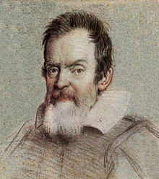
Overview
How and why objects move as they do has fascinated scientists for thousands of years.
In the early 1600s, the Italian astronomer Galileo Galilei suggested that, once an object is in motion, no force is needed to keep it moving.
Force is needed only to change the motion of an object.
Galileo’s ideas paved the way for Isaac Newton. Newton proposed the three basic laws of motion in the late 1600s.

Slide 3
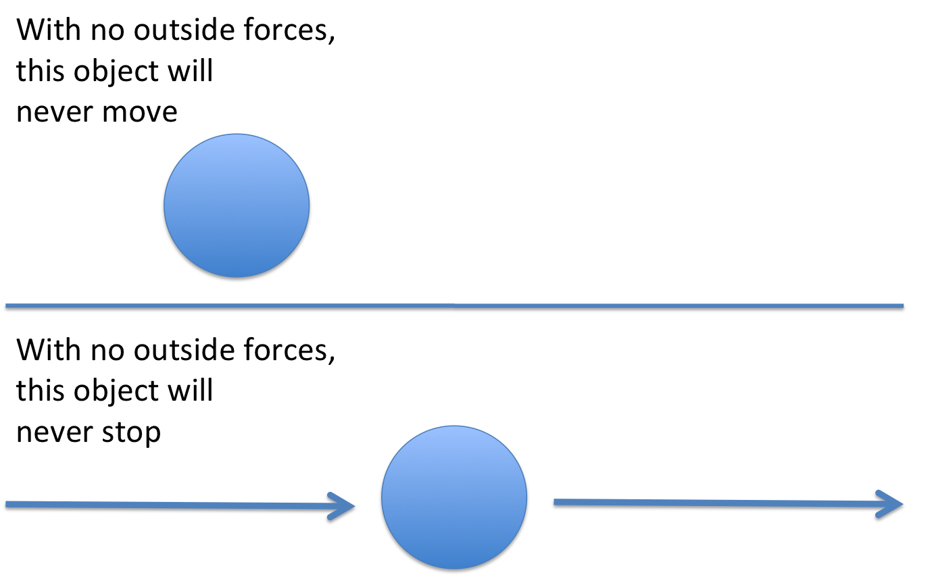
1st Law of Motion
Newton’s first law of motion states that an object at rest will remain at rest, and an object moving at a constant velocity will continue moving at a constant velocity, unless it is acted upon by an unbalanced force.

Slide 4
1st Law of Motion
If an object is not moving, it will not move until a force acts on it.
Give an example to the person sitting next to you.
If an object is already moving, it will continue to move at a constant velocity until a force acts to change either its speed or direction.
Give an example to someone else sitting near you.
On Earth, gravity and friction are unbalanced forces that often change an object’s motion so it is difficult to observe an object continuing to move at a constant velocity.

Slide 5
Inertia
Whether an object is moving or not, it resists any change to its motion.
This resistance to a change in motion is called inertia.
Inertia is the tendency of an object to resist a change in motion.
Newton’s first law is also called the law of inertia.

Slide 6
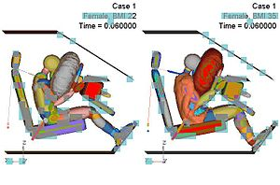
Inertia
Inertia explains many common events, such as why you move forward in your seat when a car stops suddenly.
When the car stops, inertia keeps you moving forward.
A force, such as the pull of a seat belt, is required to change your motion.

Slide 7
Inertia Depends on Mass
Some objects have more inertia than others.
The greater the mass of an object is, the greater its inertia, and the greater the force required to change its motion.

