Slide 1

Motion and Speed

Slide 2

Motion and Speed
When something moves, it changes position. It travels from one place to another. You don’t always have to see something move to know that it has moved.

Slide 3
Motion and Speed
Pair up with someone at your table group. Have your partner move something on your table while you close your eyes. Open your eyes and see if you can tell what has moved. Now you do the same thing for your partner.
How could you tell that something on your table moved?

Slide 4
Motion and Speed
Although you didn’t see the object on your desk move, you know that object moved because its position relative to the rest of the stuff on the table has changed.

Slide 5
Motion and Speed
Motion can be described as a change in position.
What do you need to have to know whether the position of something has changed?
Answer: a reference point

Slide 6
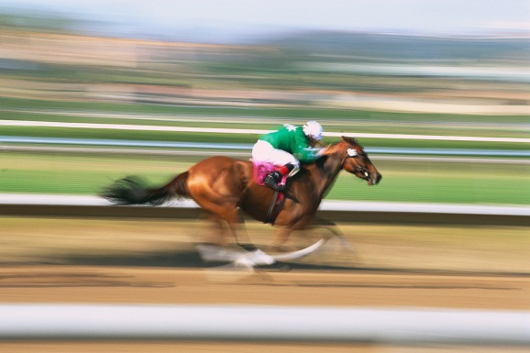
Motion and Speed
Descriptions of motion often include speed.
Speed is how fast something moves.
Predict: What is the difference between instantaneous speed and constant speed?

Slide 7
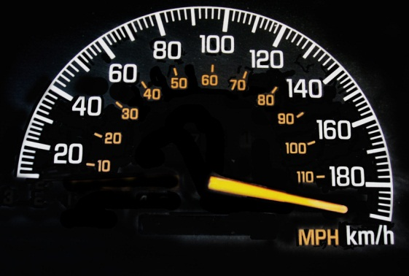
Motion and Speed
Instantaneous speed is the rate
of motion of an object at any
given moment. The speedometer
in a car shows your instantaneous speed.
Constant speed is a speed that does not vary. This is when you are traveling down the highway with the cruise control on.

Slide 8
Motion and Speed
Much of the time the speeds you deal with are not constant. When you ride your bike, your speed increases from 0 mph. You slow down to peddle up a steep hill and speed up going down the other side. You stop for a red light, speed up again, and move at a constant speed for a while. Then you slow down and stop when you arrive at your destination.
How would you express your speed on this trip? Would you use your fastest speed, your slowest speed, or one in between the two?

Slide 9
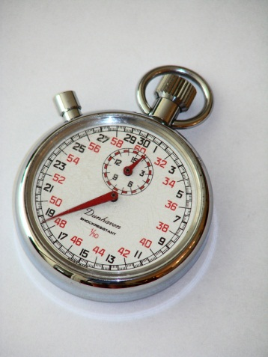
Motion and Speed
In cases where the rate of motion varies a great deal, the best way to describe speed is to use average speed.
Average speed is the total distance traveled divided by total time of travel.

Slide 10
The Tortoise and the Hare http://s409.photobucket.com/albums/pp176/belindanoid/?action=view&current=68e6181b9587d8b21a0b5f9586161ba5.mp4
Who had the fastest instantaneous speed?
Who was traveling at a constant speed?
Why did the tortoise win the race?
Answer: The tortoise’s average speed was greater than the hare’s average speed.

Slide 11
Calculating Speed – a refresher
How fast?
speed = distance/time
s = d/t

Slide 12
Calculating for Distance
How far?
Distance = speed x time
d = s x t

Slide 13
Calculating for Time
How long?
Time = distance/speed
t = d/s

Slide 14
Graphing Speed
A distance vs. time graph makes it possible to see the motion of an object over a period of time.
Let’s make a time vs. distance graph for a two-hour car trip.

Slide 15
Graphing Speed
The car covered 50 km in the first 30 minutes, stopped for 30 minutes, and covered 60 km in the final 60 minutes.

