Slide 1
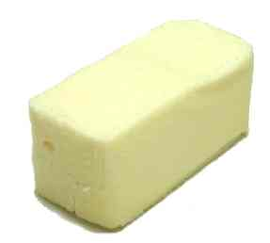
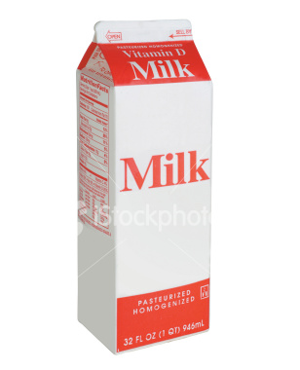
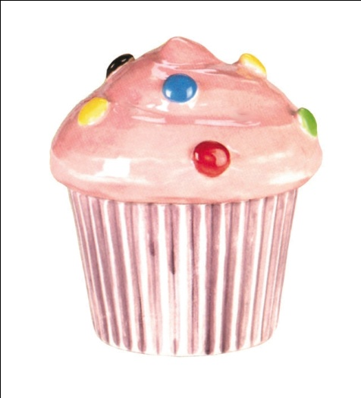
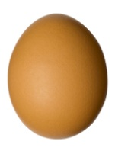
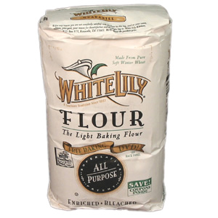
reactants
=
products

Slide 2
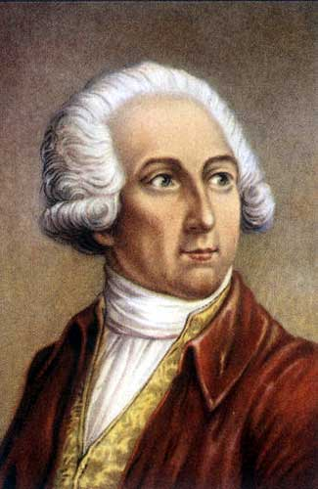
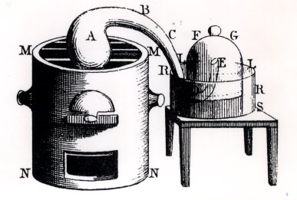
Careful observations led to the discovery of the conservation of mass.
Antoine Lavoisier’s careful quantitative experiment showed that in a chemical reaction, the total mass of reactants is always equal to the total mass of products.
2Hg(l) + O₂(g)
2HgO(s)
Mercury
Oxygen
Mercury Monoxide

Slide 3
Careful observations led to the discovery of the conservation of mass.
In other words, mass is neither created nor destroyed during chemical reactions.
Law of Conservation of Mass – atoms are not created or destroyed in a chemical reaction.
Law of Conservation of Mass – mass in a closed system cannot change.

Slide 4
Chemical reactions can be described by chemical equations.
A chemical equation represents the way in which a reaction rearranges the atoms in chemicals.
To write an equation, you must know the reactants and products, their chemical formulas, and the direction of the reaction.
The arrow in an equation indicates the direction of the reaction.
CH₄ + 2O₂ → CO₂ + 2H₂O
O
O
H
H
+
C
+
H
H
O
O

Slide 5
Law of Conservation of Mass
Sean Gillette, EdD
Master Teacher Project
Betterlesson.com
July 24, 2014

