Slide 1
Genetics and Heredity

Slide 2
Nevada Science Standards
Students know heredity is the passage of genetic instructions from one generation to the next generation
Students know changes in genes of eggs and sperm can cause changes in inherited characteristics.
Students know some characteristics of an organism are the result of a combination of interaction with the environment and genetic information.

Slide 3
Students know heredity is the passage of genetic instructions from one generation to the next generation
Students can differentiate between asexual and sexual reproduction
Students know reproduction of organisms includes
cell division
the transfer of genetic information
the probability of certain characteristics being passed from one generation to the next

Slide 4
Students know reproduction of organisms includes the transfer of genetic information
Remember when we learned about meiosis? We learned that to make a new organism, half of the chromosomes come from mom and half of the chromosomes come from dad. (This is why sex cells have only half the chromosomes that body cells have). This is how genetic information is transferred from parents to offspring.
Offspring: the children of the parents

Slide 5
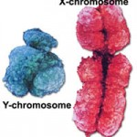
Determining the Sex of Offspring
Before we get into how inheritance of genetic traits works, we first need to understand how you become either male or female.
There are chromosomes that
determine the sex of an individual.
We call them the X and Y
chromosomes (because they look
like the letters X and Y!).

Slide 6
Determining the Sex of Offspring
Females have two X chromosomes.
Males have one X and one Y chromosome.
Females produce eggs that have only an X chromosome (Mom has two X chromosomes – they are matching pairs and will pair up during the first part of meiosis. Through the process of meiosis, the matching pairs get pulled apart and put into different cells.)
Males produce sperm that have either an X or a Y chromosome
(Dad has an X and Y chromosome – they are matching pairs as well)

Slide 7
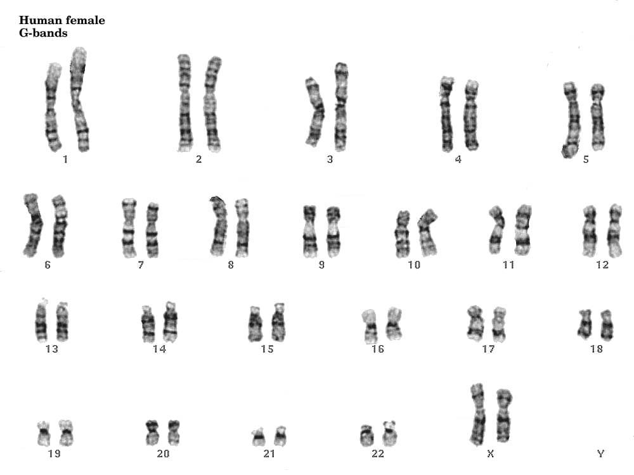

Slide 8
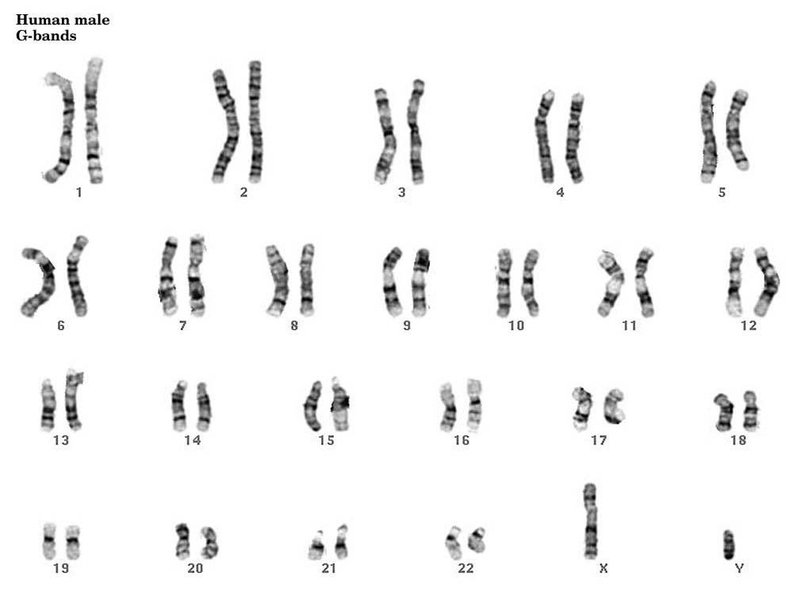

Slide 9
Determining the Sex of Offspring
+ =
+ =
X
X
XX
female
X
Y
XY
male

Slide 10
Determining the Sex of Offspring
There is a 50:50 chance that an offspring will be male or female. Each time a couple has a baby, they have a 50% chance of having a boy and a 50% chance of having a girl.
Let’s explore this concept a bit further with a brief activity.
Flip a coin 10 times and mark your results for each flip
Try to predict the next coin flip
Flip your coin 20 more times
Count up how many times you saw each side of the coin. Are the numbers close?
Now find the percentage for each side of the coin. (How many times you saw one side divided by the total number of flips) X 100. Are you close to 50%?
What do you predict the percentage would be if we used the data from everyone in the class. Would it be closer to 50%?
Did the previous flips affect the next flip?

Slide 11
Determining the Sex of Offspring
The concept we just explored with the coin flip is called probability.
Probability is the chance that something will happen - how likely it is that some event will happen. You can measure probability with a percentage (50% chance of being a boy or girl) or with a ratio (50:50 chance of being a boy or girl).

Slide 12
Heredity of Traits
Heredity is the passing of traits from parent to offspring
Traits are controlled by genes (sections of DNA that code for making specific proteins that affect the traits of an individual).
When matching pairs of chromosomes separate into sex cells during meiosis, matching pairs of genes also separate.
As a result, each sex cell ends up with one form of a gene for each trait that an organism shows. This gives us genetic variation.

Slide 13
Heredity of Traits
If the trait is for eye color, then the gene in one sex cell (say, the egg) may control one form of the trait, such as blue eyes. The gene for eye color in the other sex cell (the sperm) may control a different form of the same trait, such as brown eyes.
The different forms a gene may have for a trait are called alleles.

Slide 14
Heredity of Traits
The study of how traits are inherited through the combining of alleles is the science of genetics.
Many times there are just two forms of an allele. Examples include:
hitchhiker’s thumb vs. straight thumb
straight hairline vs. widow’s peak
In each of these examples, there are only two possibilities for alleles.
Let’s explore some of these traits that are controlled by just two alleles with an inherited traits survey.

Slide 15
Heredity of Traits
Each parent provides an allele for a trait. For example, mom could provide the allele for a hitchhiker’s thumb and dad could provide the allele for a straight thumb.
What would their child have, a hitchhiker’s thumb or a straight thumb?
There is a way to figure out the percent chance that the child will have a hitchhiker’s thumb or a straight thumb.
To figure out the probability that an offspring will have a certain trait you can use a Punnett square.

Slide 16
Punnett Square
Making a Punnett square is kind of like a game or puzzle. Games and Puzzles have rules. Here are the rules for making a Punnett square:
Represent the alleles with a letter. Example: H for hitchhiker’s thumb
Always use the same letter for the alleles of a trait. Example: h for straight thumb (instead of s).
Use capital letters for the dominant allele, and lower case letters for the recessive allele.
Dominant = the allele that dominates or hides the other allele (the allele that is expressed)
Recessive = the allele that gets hidden by the dominant allele but appears (is expressed) when not paired with a dominant allele

Slide 17
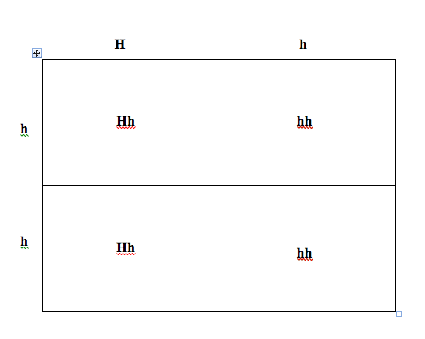
Punnett Square
4) Draw the Punnett square box and write the alleles provided by each parent along the top and side.

Slide 18
Punnett Square
Problem: Tall is dominant over short. Cross a purebred tall plant (TT) with a purebred short plant (tt).
T T
t Purebred means that their alleles are the same
t t
Tt
Tt
Tt
Tt

Slide 19
Punnett Square
Problem: Purple flowers are dominant over white flowers. Cross a purebred purple with a purebred white.
P P
p
p

Slide 20
Genotypes vs. Phenotypes
By representing alleles using letters, you get the genotypes of the offspring. The genotypes of all the offspring of the purebred tall and purebred short plants was Tt.
Genotype: An organism’s genetic makeup, or allele combinations.

Slide 21
Genotypes vs. Phenotypes
The phenotype of an organism is its physical appearance
For example: Being tall or having white flowers

Slide 22
Genotypes vs. Phenotypes
Problem: Tall is dominant over short. Cross a purebred tall plant (TT) with a purebred short plant (tt).
The phenotypes of the offspring of the purebred tall and purebred short plants will all be tall.
This is because tall is dominant over short.
Tt
Tt
Tt
Tt

Slide 23
Genotypes vs. Phenotypes
Problem: Cross the hybrid offspring of the tall and short plants. Hybrid means that their alleles are different.
T t
T
t
Possible Genotypes:
TT, Tt, tt
Possible Phenotypes:
TT = tall
Tt = tall
tt = short

Slide 24
Homozygous vs. Heterozygous
We can name the various genotypes. If the alleles are both the same (what we called purebred earlier), then we call the genotype homozygous. For example: TT or tt
If the alleles are different (what we called hybrid earlier), then we call the genotype heterozygous. For example: Tt

Slide 25
Homozygous vs. Heterozygous
Tt = heterozygous
TT = homozygous
tt = homozygous
How can we tell the two homozygous ones apart?
Tt = heterozygous
TT = homozygous dominant
tt = homozygous recessive

Slide 26
Gregor Mendel
Gregor Mendel was an Austrian Monk who is considered to be the father of genetics. Mendel began experimenting with garden peas in 1856. He thought it would be possible to predict the kinds of flowers and fruit a plant would produce. But something had to be known about the parents of a plant before a prediction could be made. Mendel recorded this information and then crossed specific plants by pollinating them himself. He recorded his data and after 8 years of research, he published a paper on his findings about dominant and recessive traits. Although he did not gain any notoriety in his lifetime, his work was rediscovered in 1900 by three other scientists who had reached similar conclusions.

Slide 27
Some of Mendel’s Results
Traits | Shape | Seed (pea) Color | Pod Color | Pod Shape | Plant Height | Flower Position | Flower Color
dominant | smooth | yellow | green | full | tall | leaf junctions | purple
recessive | wrinkled | green | yellow | flat | short | tips of branches | white
Problem 1: Cross a homozygous recessive wrinkled pea with a heterozygous smooth pea.
Problem 2: Cross a heterozygous yellow pea with a homozygous dominant yellow pea

