Slide 1
Evidence for Evolution

Slide 2
Evidence # 1 – The Fossil Record
The most abundant evidence for evolution comes from fossils that have been found all over the world.
Fossils are any remains of life from an earlier time.

Slide 3
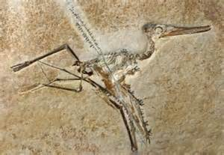
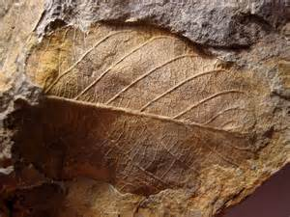
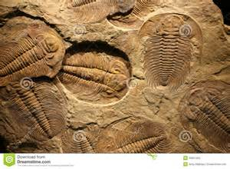
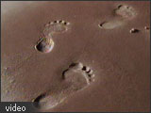
Examples of Fossils
1. The imprint of a leaf, feather, or organism in a rock.

Slide 4
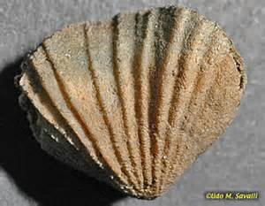
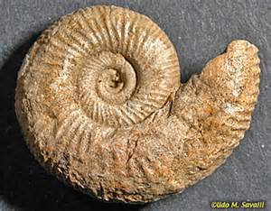
Examples of Fossils
2. A cast made of minerals that filled in the hollows of an animal track, mollusk shell, or other parts of an organism.

Slide 5
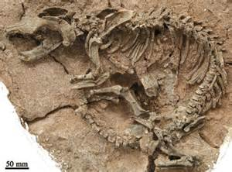
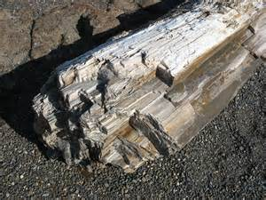
Examples of Fossils
3. A piece of wood or bone replaced by minerals

Slide 6
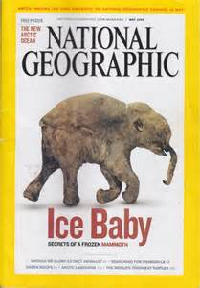
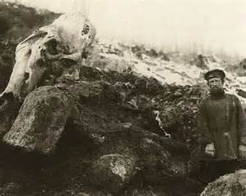
Examples of Fossils
4. An organism frozen in ice

Slide 7
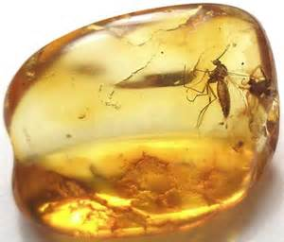
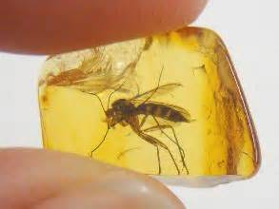
Examples of Fossils
5. An insect or other organism trapped in plant resin. Example: mosquitoes in amber, like in the movie Jurassic Park.

Slide 8
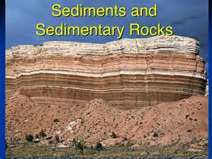
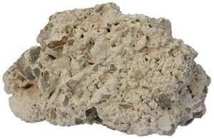
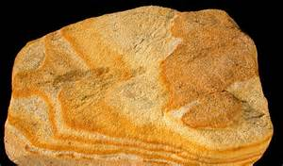
Evidence #1 – The Fossil Record
Sedimentary rock contains the most fossils. Sedimentary rock is a rock type formed by mud, sand, or other fine particles that settle out of a liquid (like water). Limestone, sandstone, and shale are all examples of sedimentary rock. Fossils are found more often in limestone than in any other kind of sedimentary rock.

Slide 9
Evidence #1 – The Fossil Record
To figure our the age of a fossil, scientists have a couple of different methods. Scientists have divided Earth’s history up into eras and periods.
These divisions make up the geologic time scale.

Slide 10
Evidence #1 – The Fossil Record
Unique rock layers and fossils give information about the geology, climate, and life forms of each time period.
There are two (2) basic methods for reading the record of past life.
When these two methods are used together, accurate estimates of the ages of certain rocks and fossils are made.

Slide 11
Evidence #1 – The Fossil Record
Relative Dating
One method often used to figure out the approximate age of a rock layer, or fossils within the layer is to look where the particular rock layer is. In undisturbed areas, older rock layers lie below successively younger rock layers.

Slide 12
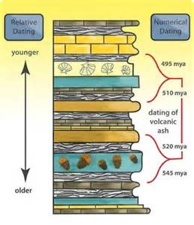
Evidence #1 – The Fossil Record
Fossils found in the lowest layers of rock are older than those in upper layers. This method of dating fossils is known as relative dating. Relative dating can only estimate the age of a fossil.

Slide 13
Evidence #1 – The Fossil Record
Radioactive Dating
A method used to give a more accurate age to a rock layer or fossil is dating using radioactive elements.
Radioactive elements give off radiation, a form of atomic energy.

Slide 14
Evidence #1 – The Fossil Record
Uranium and a radioactive form of carbon are used in radioactive dating.
Radioactive elements change to more stable products as they give off radiation.
The radiation is given off at a constant rate, and the rate is different for each element.

Slide 15
Evidence #1 – The Fossil Record
Scientists can measure how much of a radioactive element has changed.
They can accurately tell the age of the rock by comparing the amount of stable product with the amount of radioactive element still present.

Slide 16
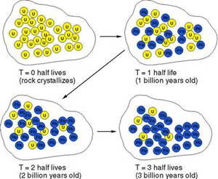
Evidence #1 – The Fossil Record
For example, the radioactive element uranium changes to lead as it ages. Scientists can determine how old a fossil in a rock sample is by measuring the amounts of uranium and lead in the rock. The more lead there is, the older the rock, and by association, the older the fossil.

Slide 17
Evidence #1 – The Fossil Record
Fossils are a record of organisms that lived in the past. But the fossil record is incomplete, much like a book with some pages missing. Because every living thing doesn’t or can’t become fossilized, the record will never be complete.

Slide 18
Evidence #1 – The Fossil Record
By looking at fossils, scientists have figured out that many simpler forms of life existed earlier in Earth’s history, and more complex forms appear later.

Slide 19
Evidence #1 – The Fossil Record
The oldest fossil bacteria appeared 3.8 billion years ago.
Simple invertebrates appeared in the Cambrian period, about 540 million years ago.
The first land plants did not appear until the Silurian period, 438 million years ago.

Slide 20
Evidence #1 – The Fossil Record
Dinosaurs ruled the Earth during the Triassic and Jurassic periods, from 208 to 144 million years ago.
The first mammals and birds did not appear until the Jurassic period, about 200 million years ago.
The fossil record gives scientists convincing evidence that living things evolved.

Slide 21
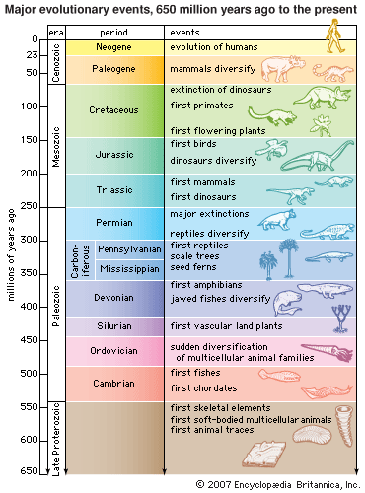

Slide 22
Evidence #2 – Homologous Structures
Homologous Structures
You know that the functions of your arm, a dolphin’s flipper, a bat’s wing, and a bird’s wing are all very different. Yet, as you will see, each of the structures is made up of the same kind of bones. Each has about the same number of muscles and blood vessels.

Slide 23
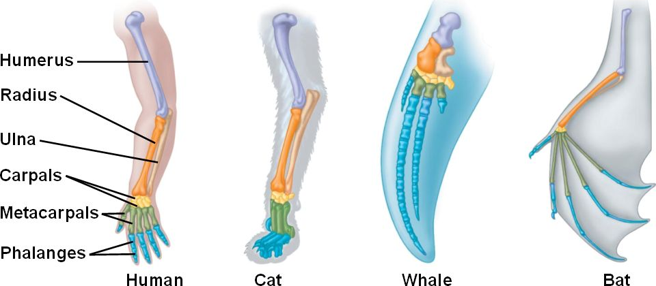

Slide 24
Evidence #2 – Homologous Structures
Each of these limbs developed from similar tissues in the embryo.
Body parts that are similar in origin and structure are called homologous.
Homologous structures give evidence that two or more species shared common ancestors.

Slide 25
Evidence #3 – Vestigial Structures
Vestigial structures also give evidence for evolution.
A vestigial structure is a body part that is smaller in size and doesn’t seem to have a function.

Slide 26
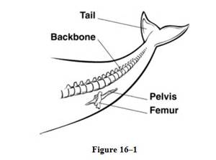
Evidence #3 – Vestigial Structures
Examples of the vestigial organs in humans are the appendix and the muscles that move the ear.
Whales no longer have back legs, but they still have the bones of the pelvis.
Scientists think vestigial structures are parts that once functioned in an ancestor.

Slide 27
Evidence #4 - Embryology
The study of the development of embryos is called embryology.
An embryo is an organism in its earliest stages of development.

Slide 28
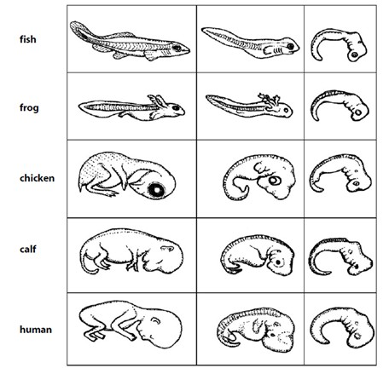
Evidence #4 – Embryology

Slide 29
Evidence #4 - Embryology
In the early stages of development, the embryos of fish, reptiles, birds, and mammals have a tail and gills or gill slits.
Fish keep their gills, but the other organisms lose them as their development continues.
In humans, the tail disappears, but fish, birds, and lizards keep their tails.

Slide 30
Evidence #4 - Embryology
These similarities suggest that all vertebrate animals (animals with a backbone) are related.
This supports evidence from the fossil record that shows aquatic, gill-breathing organisms evolved before air-breathing land vertebrates.

Slide 31
Evidence #5 - DNA
DNA is the molecule that controls heredity.
Scientists can determine whether or not organisms are closely related by comparing their DNA.
Organisms that are close relatives have similar DNA.

Slide 32
Evidence #5 - DNA
By studying DNA, scientists have determined dogs are the closest relatives to bears.
You would probably not be surprised to learn that gorillas and chimpanzees also have similar DNA.
Genetic evidence also supports the view that primates all came from a common ancestor.

Slide 33
Evidence #5 - DNA
DNA changes over time due to mutations.
Organisms B and C
are distant relatives.
A lot of time has passed
since they shared a
common ancestor.
The DNA has had more
time to change/mutate.
B
A
Organisms
A and B are closely
related. DNA hasn’t
had much time to change
or mutate. The DNA of
organisms A and B will
still be similar.
C

