Slide 1
Combining Forces

Slide 2
What is a Force?
A force is a push or a pull.
Exert a (gentle) force on an object near you.
If you are sitting quietly at your desk without moving, are you exerting any forces? Is anything exerting a force on you?

Slide 3
What is a Force?
Like velocity and acceleration, a force is described by its magnitude and by the direction in which it acts.
What was the
name we gave
to these arrows?
Vectors

Slide 4
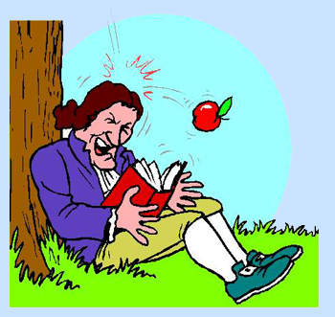
What is a force?
The strength of a force is measured in the SI unit called the newton (N).
Named after Sir Isaac Newton
You exert about one newton of force when you lift a small lemon.

Slide 5
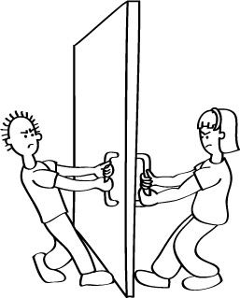
Combining Forces
Often, more than a single force acts on an object at one time.
The combination of all forces acting on an object is called the net force.
The net force determines whether an object moves and also in which direction it moves.

Slide 6
Combining Forces
When forces act in the same direction, the net force can be found by adding the strengths of the individual forces.

Slide 7
Combining Forces
When forces act in opposite directions, they also combine to produce a net force. This time they combine by subtraction.
Adding a force in one direction to a force in the opposite direction is the same as adding a positive number to a negative number.
The net force always acts in the direction of the greater force.

Slide 8
Combining Forces
If the opposing forces are of equal strength, there is no net force
There is no change in the object‘s motion

Slide 9
Balanced and Unbalanced Forces
Whenever there is a net force acting on an object, the forces are unbalanced.
Unbalanced forces can cause an object to start moving, stop moving, or change direction.

Slide 10
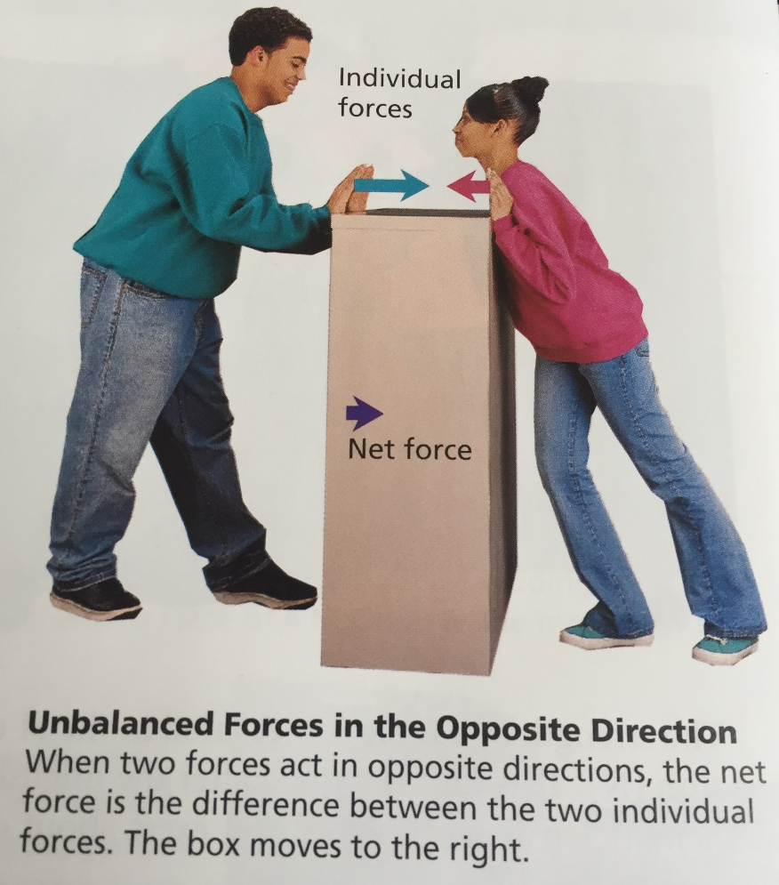
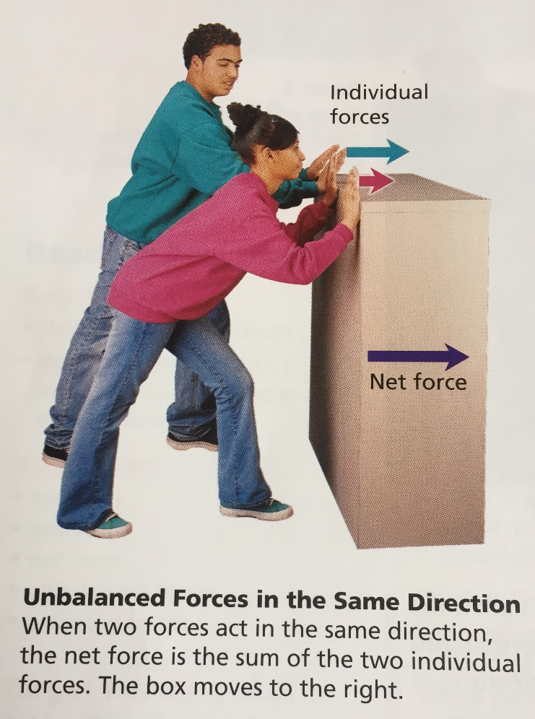
Balanced and Unbalanced Forces
Unbalanced forces acting on an object result in a net force and cause a change in the object‘s motion.

Slide 11
Balanced and Unbalanced Forces
Equal forces acting on one object in opposite directions are called balanced forces.
Balanced forces acting on an object do not change the object’s motion.

